Slide 1



SQL
By DSC.
Download link: https://dev.mysql.com/downloads/installer/

Slide 2
Why SQL?
The advantages of learning SQL are expanding and significant. SQL had a colossal increment in utilization during the most recent couple of years.
1. Universal Language
Remember that SQL is case-insensitive but the variables that you create are case-sensitive.
SQL is one of the techniques that seeps over into other numerous disciplines. When you work with SQL, you’re using the computer’s language. This stimulates you to progress into coding with other different languages, for example, C++, Javascript, Python, and others. All these languages are invaluable and still in demand.

Slide 3
Why SQL?
2. Open-Source – Easy to learn and use
SQL is an open-source programming language, so it has a large community of developers. Many topics that relate to SQL and MySQL are posted on StackOverflow consistently. SQL is comparatively easier to learn than other programming languages, for example, C++. Also, a considerable number of the prevalent databases that use SQL (MySQL, MariaDB, and Postgres) are open-source.

Slide 4
Why SQL?
3. Manage Million Rows of Data
Traditional spreadsheets can be used to manage small-to-medium-sized sets of information, so we will require an alternate solution when managing such huge records. Gratefully, this is a field, in which SQL sparkles: regardless of whether it’s 1,000 records or 100 million, SQL is completely equipped to handle data pools of virtually all sizes.

Slide 5
Why SQL?
4. High in Demand
There aren’t many individuals in the present workforce who have a working experience in SQL. Many businesses perceive the value of such a skill in the current market. However, it’s a simple sell to make.
Companies are currently searching out those individuals who are skilled in SQL. It’s one thing to have the capacity to gain a high salary. However, employers know the worth that somebody, who is skilled in SQL, leads to their association and need to hire these people. Also, in case you want to change a job, learning SQL makes you a favorably sought after prospect.

Slide 6
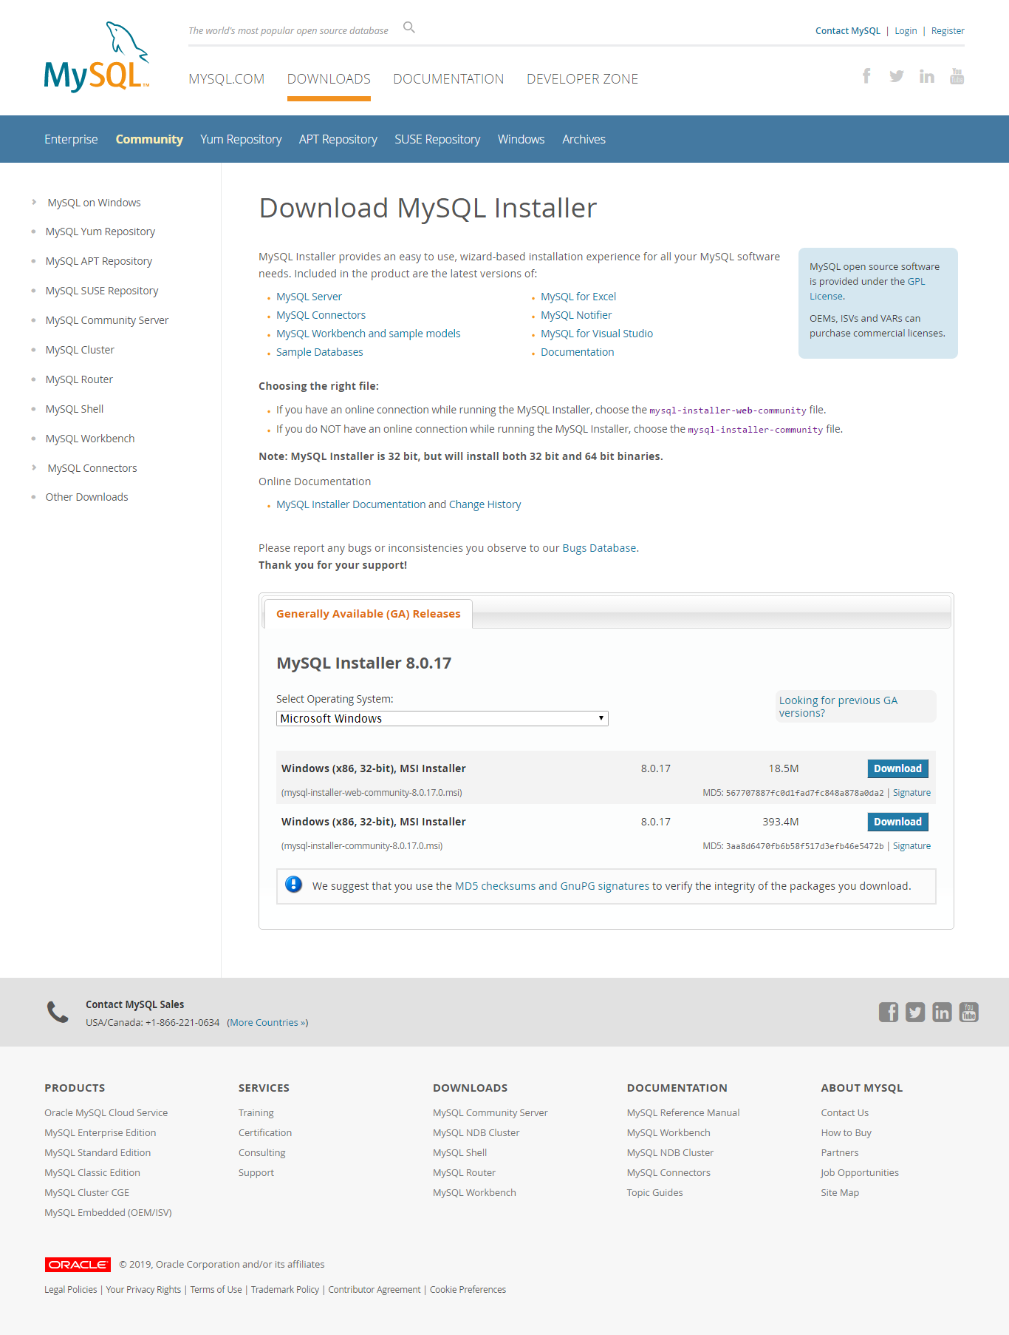
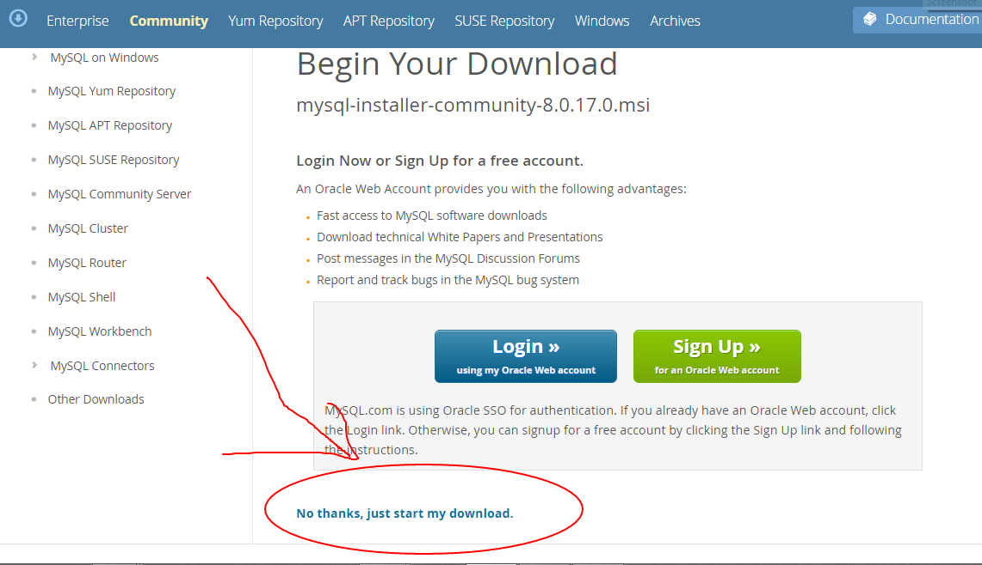
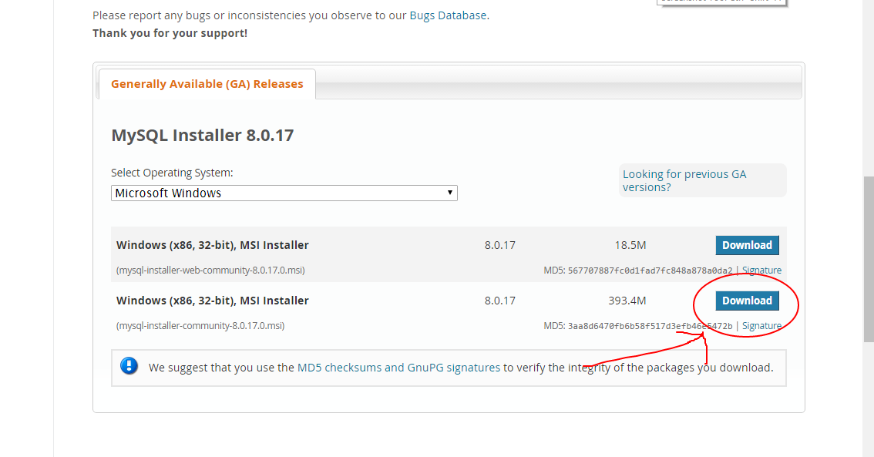
Let’s INSTALL…
GET it here ☺ :-
https://dev.mysql.com/downloads/installer/

Slide 7
Structured Query Language
Structured Query Language (SQL) is the language standardized by the American National Standards Institute (ANSI) and the International Organization for Standardization (ISO) for use on relational databases.
It is a declarative rather than procedural language, which means that users declare what they want without having to write a step-by-step procedure.
The SQL language was first implemented by the Oracle Corporation in 1979, with various versions of SQL being released since then.

Slide 8
Let’s Start (Tables, similar to spreadsheet in excel) In Sql: Columns: ATTRIBUTES Rows: TUPLES The schema of a table is the table name and its attributes: Product(PName, Price, Category, Manfacturer) A key is an attribute whose values are unique; we underline a key (eg: primary key) Product(PName, Price, Category, Manfacturer)

Slide 9
Creating a Database Before creating a database first type in: “show databases;” to show all the databases available To create a new database, type in “create database DATABASENAME;” command: mysql> create database sample; Once the database is created try: ‘show databases;’ command again To the select a database, type in “use” command: mysql> use sample;

Slide 10
Creating a Database Once our database is created its time to create tables and start working on it. So first we need to learn some data-types to work with attributes.

Slide 11

Data Types in SQL
Characters: CHAR(20), VARCHAR(50)
Numbers: INT, BIGINT, SMALLINT, FLOAT
Others: MONEY, DATE, TIME, …

Slide 12
Data Definition Language (DDL)
Create/alter/delete tables and their attributes
Data Manipulation Language (DML)
Query one or more tables
Insert/delete/modify tuples in tables

Slide 13
Data Definition Language (DDL)
The most important DDL statements in SQL are:
CREATE TABLE - creates a new database table
ALTER TABLE - alters (changes) a database table
DROP TABLE - deletes a database table
CREATE INDEX - creates an index (search key)
DROP INDEX - deletes an index

Slide 14
Data Manipulation Language (DML)
SQL (Structured Query Language) is a syntax for executing queries. But the SQL language also includes a syntax to update, insert, and delete records.
These query and update commands together form the Data Manipulation Language (DML) part of SQL:
SELECT - extracts data from a database table
UPDATE - updates data in a database table
DELETE - deletes data from a database table
INSERT INTO - inserts new data into a database table

Slide 15
How to create a DB table?
Use CREATE TABLE query, specifying fields and column types:
CREATE TABLE table_name ( column_name1 data_type(size), column_name2 data_type(size), column_name3 data_type(size), .... );

Slide 16
Describing Tables
To see structure of the table you’ve created use ‘describe TABLENAME’:
mysql> describe pet;
+---------+-------------+------+-----+---------+-------+
| Field | Type | Null | Key | Default | Extra |
+---------+-------------+------+-----+---------+-------+
| name | varchar(20) | YES | | NULL | |
| owner | varchar(20) | YES | | NULL | |
| species | varchar(20) | YES | | NULL | |
| sex | char(1) | YES | | NULL | |
| birth | date | YES | | NULL | |
| death | date | YES | | NULL | |
+---------+-------------+------+-----+---------+-------+
6 rows in set (0.02 sec)

Slide 17
The INSERT INTO Statement
The INSERT INTO statement is used to insert new rows into a table.
Syntax
INSERT INTO table_name
VALUES (value1, value2,....)
You can also specify the columns for which you want to insert data:
INSERT INTO table_name (column1, column2,...)
VALUES (value1, value2,....)

Slide 18
SQL Constraints
In SQL, we have the following constraints:
NOT NULL - Indicates that a column cannot store NULL value
UNIQUE - Ensures that each row for a column must have a unique value
PRIMARY KEY - A combination of a NOT NULL and UNIQUE. Ensures that a column (or combination of two or more columns) have a unique identity which helps to find a particular record in a table more easily and quickly
FOREIGN KEY - Ensure the referential integrity of the data in one table to match values in another table
CHECK - Ensures that the value in a column meets a specific condition
DEFAULT - Specifies a default value for a column

Slide 19
How to use SQL constraints: You can add constraint at the time of creating a table or by using alter command.
CREATE TABLE table_name ( column_name1 data_type(size) constraint_name, column_name2 data_type(size) constraint_name, column_name3 data_type(size) constraint_name, .... );

Slide 20
Examples to use constraints:
CREATE TABLE table_name ( column_name1 data_type(size) PRIMARY KEY, column_name2 data_type(size) NOT NULL, column_name3 data_type(size) DEFAULT ‘default parameter’, column_name4 data_type(size) UNIQUE, FOREIGN KEY(column_name1) REFERENCES table2(column_name4), );

Slide 21

NOW PRACTISE THE FOLLOWING QUESTIONS.
The following questions are given from the next slides for your iwn practise in sql do go through them.
And then proceed with the word file of codes that are given with the distribution.

Slide 22
Use Show tables; to display all tables in database Use ‘in’ to query from a selected list Eg: select * from table where name in (‘abc’, ‘def’, ‘ghi’);
Change table structure DML (Using alter command):
Alter TABLENAME add COLUMNNAME DATATYPE;
Alter TABLENAME modify COLUMNNAME DATATYPE;
Alter TABLENAME rename column COLUMN1 TO COLUMN2;

Slide 23
Use Show tables; to display all tables in database Use ‘in’ to query from a selected list Eg: select * from table where name in (‘abc’, ‘def’, ‘ghi’);
Change table structure DDL (Using alter command):
Alter TABLENAME add COLUMNNAME DATATYPE CONSTRAINTS;
Alter TABLENAME modify COLUMNNAME DATATYPE;
Alter TABLENAME rename column COLUMN1 TO COLUMN2;
Alter TABLENAME add PRIMARY KEY(COLUMNNAME);
Rename table sample to sample1

Slide 24
DELETE table: drop table TABLENAME;
Change data from table DML (Using update command):
Update TABLENAME set columnname=oldvalue where columnname=newvalue;
Delete all rows from a table:
Delete from TABLENAME;

Slide 25
PRACTISE MAKES YOU PERFECT AND IN SQL PERFECTION IS UTMOST REQUIRED. So it’s advisable to keep the practising of codes else it’s really easy in sql to forget the syntax and then students make silly mistakes in their codes.

Slide 26

Conclusion
That’s all for now folks. This ppt covers the basic syntax for SQL that may give you an idea for the beginning of your journey in sql. Do look into the codes(the word file) that are given with the slides for better
Understanding of SQL.

Slide 27

Task:
Create a database of your name.
Create table name ‘student’
Add attributes: (name, age, marks, Enrollment number etc..)
Set constraints like primary key accordingly (enrollment number obvious)
Add some tuples of your imaginary friends.
Try to set data as real as possible
Now change all attribute names to CAPITAL. (eg: name to NAME)
Print out all the students whose marks greater than 60 and name there name contains ‘sh’

